Slide 1
Supplier Information on Advance Shipment Notification (ASN)

Slide 2
Purpose of this help guide:
1)Create a Ship Notice once the items have shipped.
2)Multiple Ship Notices per PO can be sent
3)ASNs are mandatory for All serialized products that require Asset tracking
Steps:
1. Click Create Ship Notice on the PO document
2. Check the Ship From and Deliver To information.
3. Update if required by clicking on Update Address.
4. Any field with an asterisk is required to be completed.
5. Click OK.
Create a Ship Notice

Slide 3
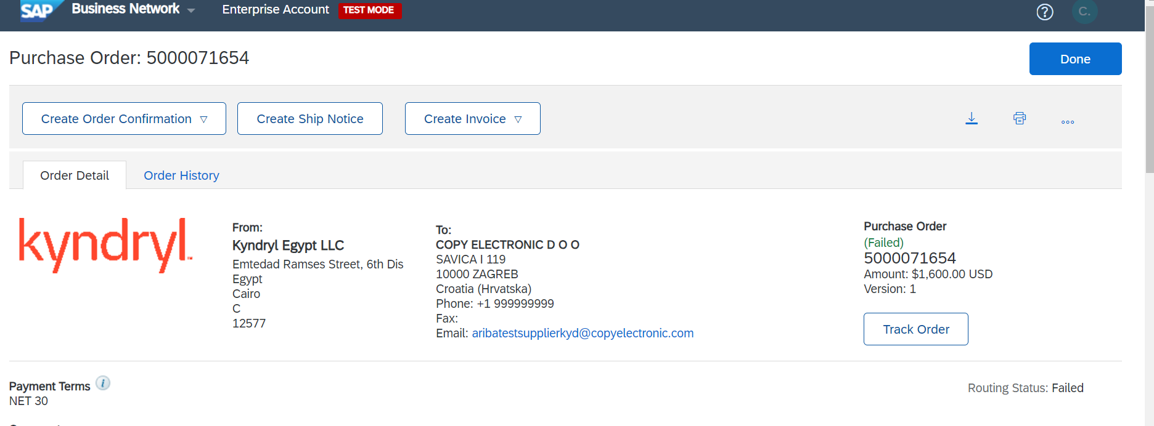

Slide 4
Ship Notice Header
Fill out the requested information on the form. The Packing Slip ID is any number you use to identify the Ship Notice. (Fields marked (*) are mandatory fields)
  Packing Slip ID (tracking number)
  Shipping Date
  Delivery Date
Choose Carrier Name and then Tracking and Shipping Method will appear.
Delivery Terms and other transportation details can be included on all Ship Notices to support a broader range of shipping information collaboration.
Add attachments if Any

Slide 5
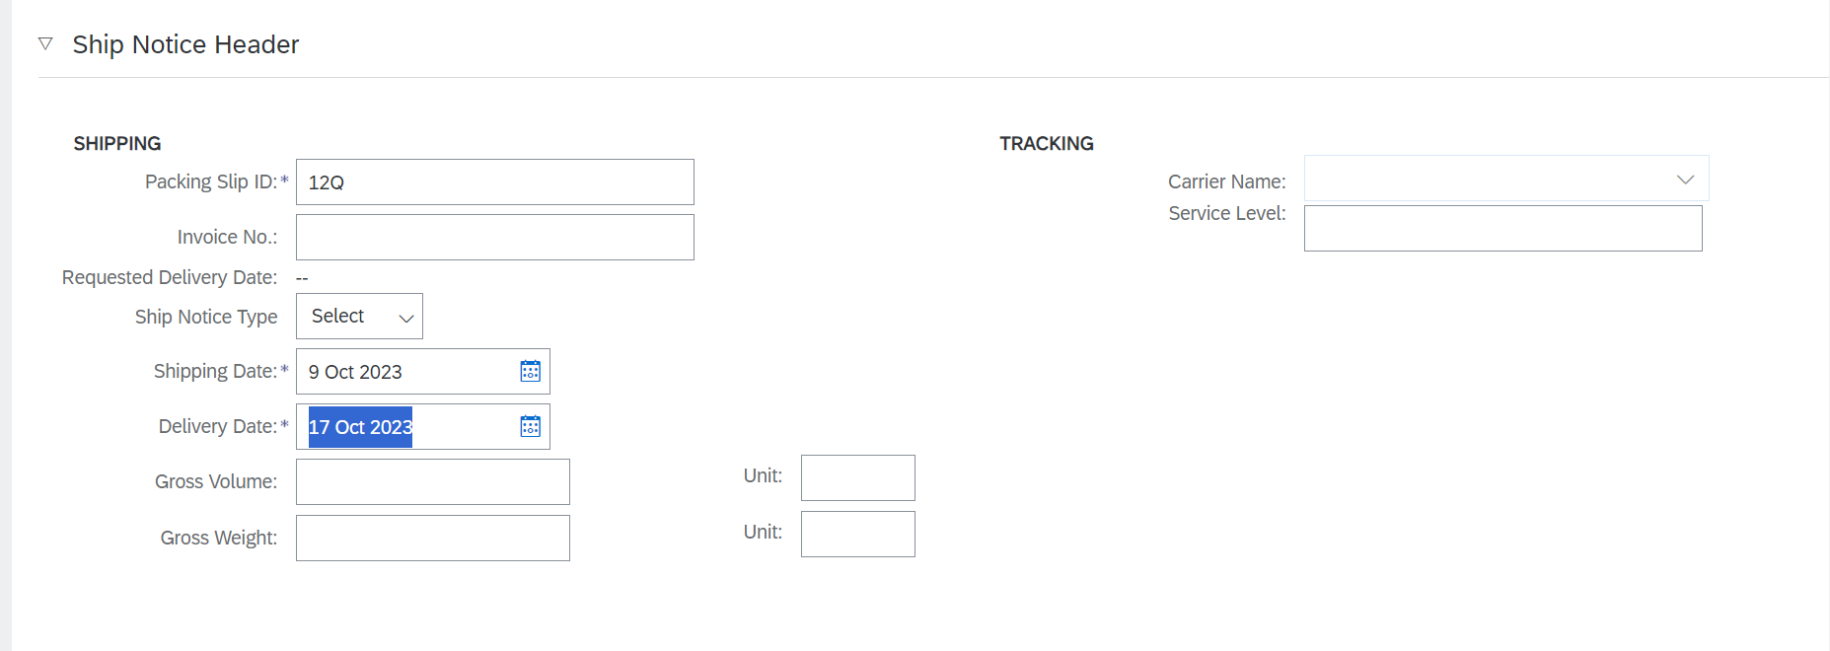

Slide 6
Line Item Details
Scroll down to view Order item information and update the quantity shipped for each line item.
Update Ship Qty to reflect quantity being shipped.
For Serialized Commodity codes, Click on Add details (far right on screen) and Fill the Serial numbers for all the items ( Note: If Q=5, then there should be 5 Serial Nos)
Click Next to proceed to review your Ship Notice.
After reviewing your Ship Notice, click Submit to send Ship Notice to your buyer.
After submitting your Ship Notice, the Order Status will be updated to Shipped.
Submitted Ship Notices can be viewed from the Fulfilment tab or by clicking the link under the Related Documents from the PO View.
Click Done

Slide 7
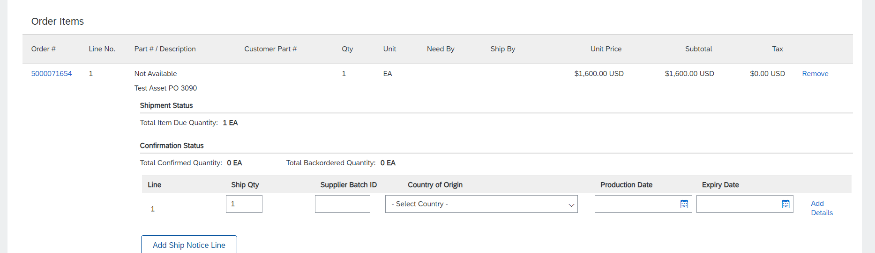
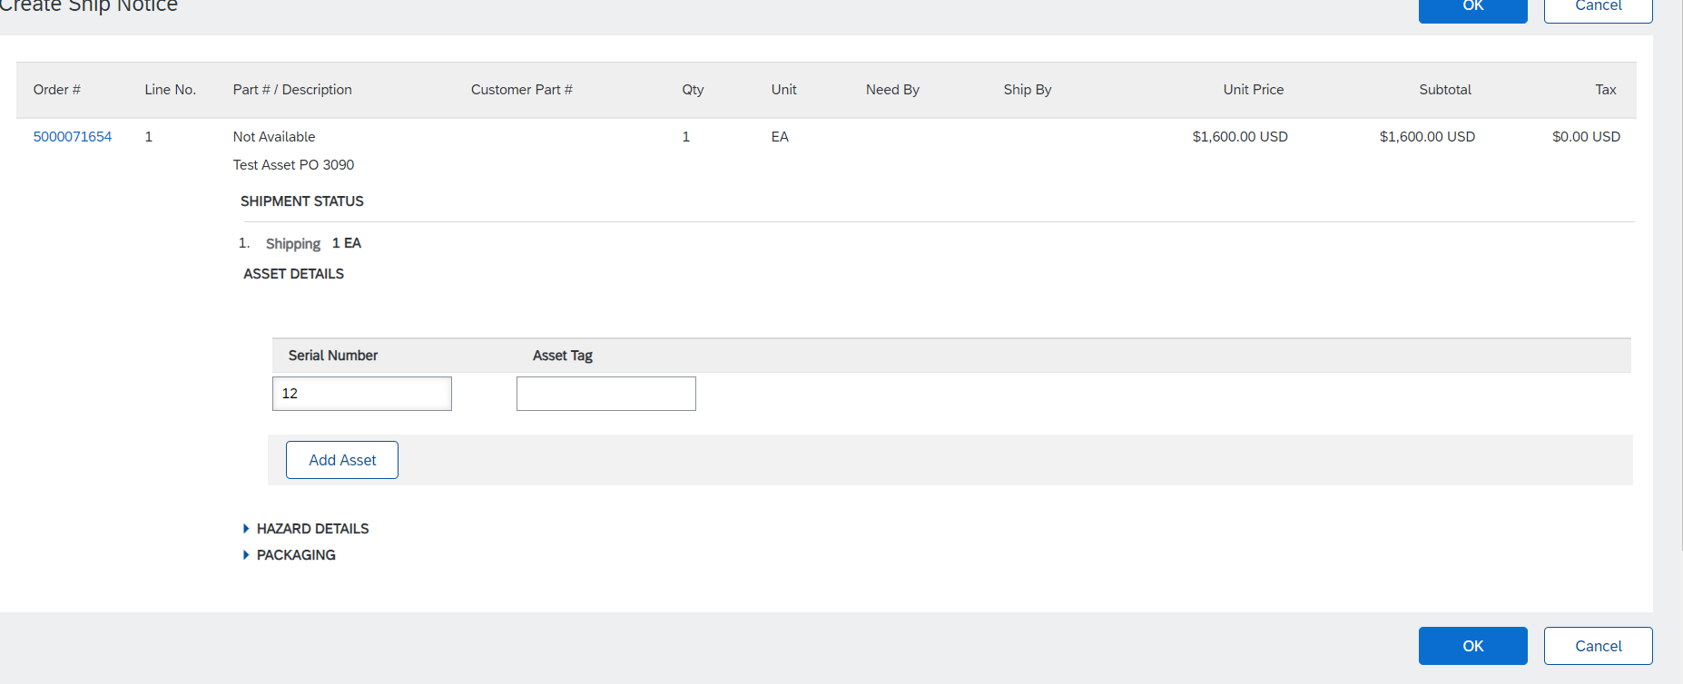

Slide 8
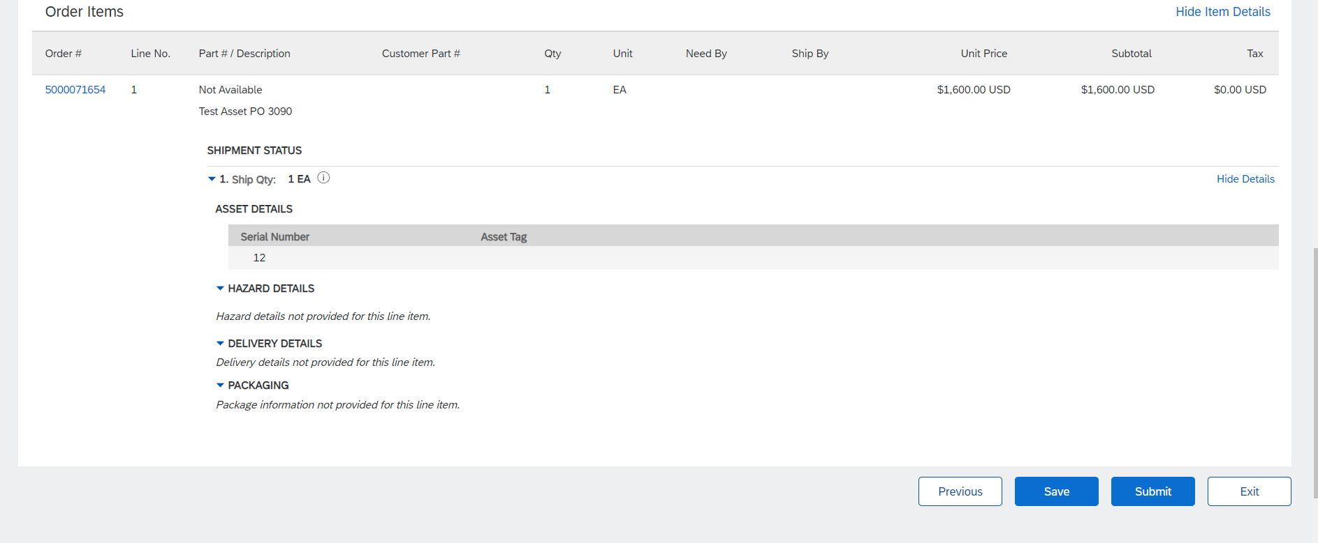

Slide 9
Invoice Submission
The Invoice create button will become highlighted AFTER the Shipment Notice has been successfully sent to Kyndryl
The Invoice creation instruction is standard SAP function and can be found on the Supplier Information Portal. The link to the SIP is located at the end of this guide.

Slide 10
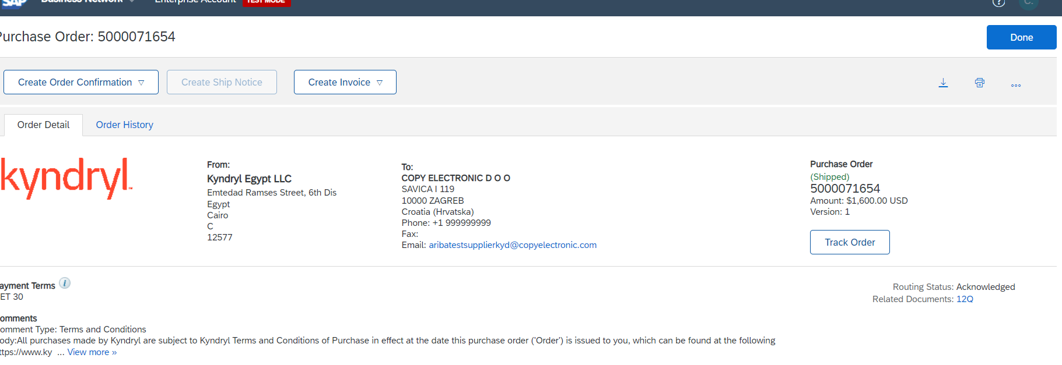

Slide 11
ASN Cancellation Scenario
The Supplier needs to cancel the ASN and resubmit it for the following scenario
When Supplier omits to enter Serial Number for Serialized Commodity codes
When ASN got stuck due to connectivity issue in S4
When the Supplier submits Invoice first instead of the ASN (ASN should be submitted first prior to sending Invoice for Asset POs)
For Any miscellaneous errors made during submission.

Slide 12
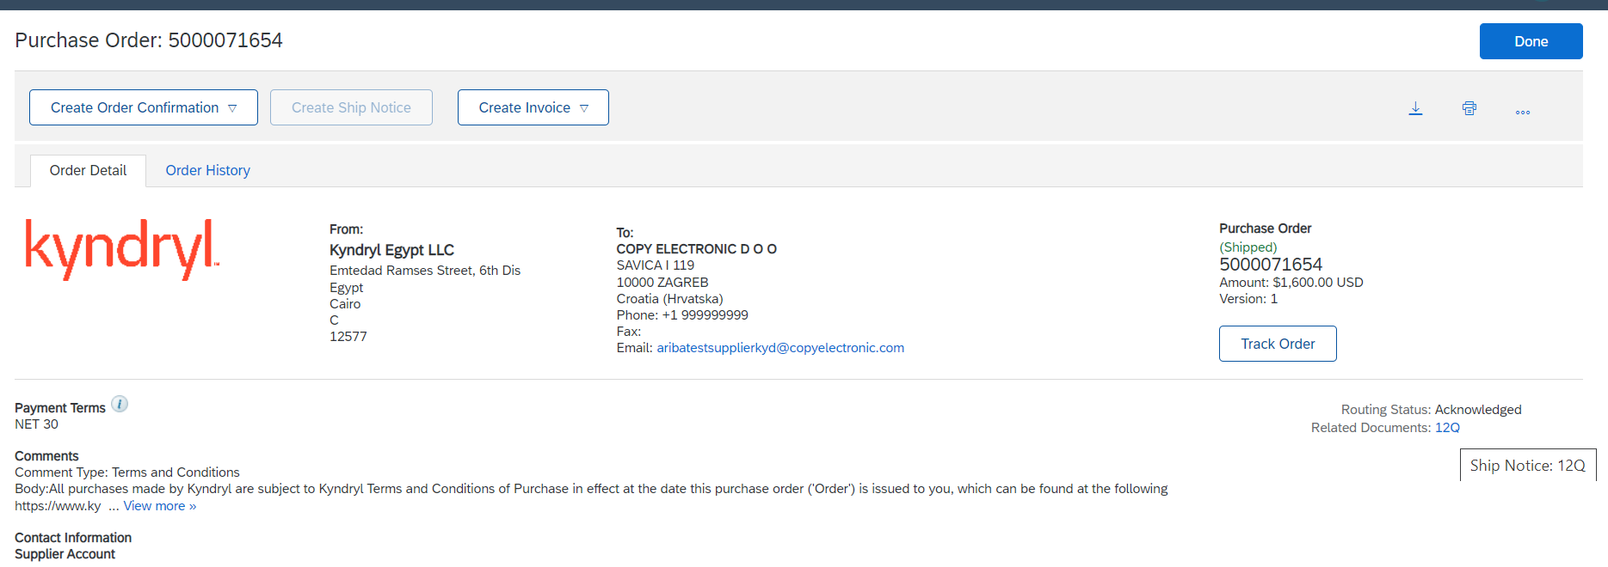
Steps to Cancel ASN
1. Click on Ship Notice on the PO

Slide 13
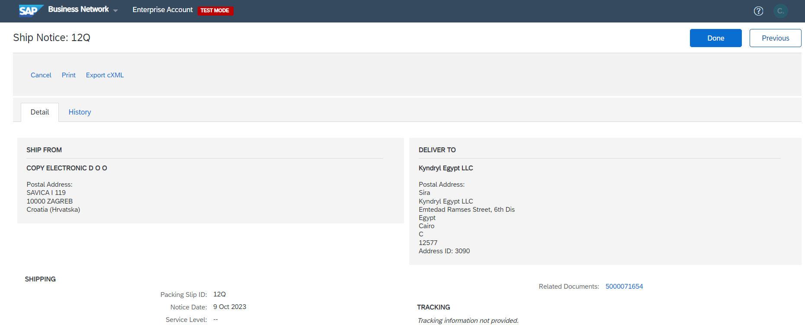
2. Click on Cancel

Slide 14
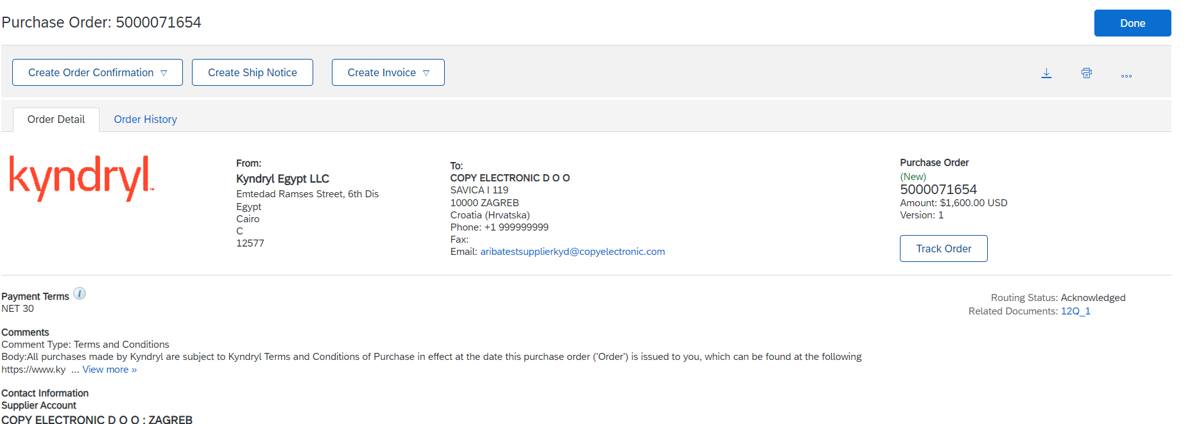
Check the PO Status defaulted to “New” from “Shipped” and the cancelled ASN document available

Slide 15
SAP Ariba Education material location
https://support.ariba.com/item/view/204041

